Slide 1
Python 3

Slide 2
Using the Python interactive Shell
The Python interpreter can be invoked (by python with no parameter)
Use cmd on Windows or a Terminal on Mac
Type python
If no Python version shows up, python3.x must be installed.
Most probably older version invoked on Mac(python 2.x)
Use quit() to quit

Slide 3
Python 2 vs Python 3
ORHANZ-23775:~ zeyneporhan$ python
Python 2.7.16 (default, Dec 3 2019, 07:02:07)
[GCC 4.2.1 Compatible Apple LLVM 10.0.1 (clang-1001.0.37.14)] on darwin
Type "help", "copyright", "credits" or "license" for more information.
>>> quit()
ORHANZ-23775:~ zeyneporhan$ python3
Python 3.8.0 (v3.8.0:fa919fdf25, Oct 14 2019, 10:23:27)
[Clang 6.0 (clang-600.0.57)] on darwin
Type "help", "copyright", "credits" or "license" for more information.
>>>

Slide 4
Python 3
The easiest way to check if a Python 3.x version is installed:
Open a Terminal.
Type in python but no return.
Instead type the "Tab" key. You will see possible extensions and other installed versions, if there are some:
ORHANZ-23775:~ zeyneporhan$ python
python python2.7-config python3.8 pythonw2.7
python-config python3 python3.8-config
python2.7 python3-config pythonw
ORHANZ-23775:~ zeyneporhan$ python

Slide 5
Python 3 First Attempt
Let’s make some mistakes and machine will complain
Be brave to use trial and error approach, you will learn a lot!
Type something that is not mentioned before
I typed CSC, machine thinks that it is a variable but not defined
If I say ‘CSC’ is a String, that will be ok
‘CSC’ or “CSC” means it is a value and String
>>> CSC103
Traceback (most recent call last):
File "<stdin>", line 1, in <module>
NameError: name 'CSC' is not defined
>>> 'CSC'
'CSC'
>>> "CSC"
'CSC'

Slide 6
Calculations
Let’s calculate now
Addition, subtraction, multiplication(use *), division, exponents, roots, etc.
>>> 2+3
5
>>> 2+3*5
17
>>> (2+3)*5
25
>>> 2**3
8
>>> 40/9
4.444444444444445
>>> 40/5
8.0
>>>

Slide 7
Calculations with variables
Let’s calculate again but using the variables
Addition, subtraction, multiplication(use *), division, exponents, roots, etc.
>>> date_of_birth = 1999
>>> current = 2020
>>> age = current-date_of_birth
>>> age
21
>>> current
2020

Slide 8
Strings
Strings are created by putting a sequence of characters in quotes
single quotes,
double quotes or
triple quotes, which are made up of three single or three double quotes.
Strings are immutable. This means that once defined, they cannot be changed.

Slide 9
Calculations with Strings
Let’s calculate again but using the variables and Strings
+ for concatenation
* for concatenation more than once
>>> greeting = 'Hello'
>>> name = 'Zeynep'
>>> greeting_with_name = greeting+name
>>> greeting_with_name
'HelloZeynep'
>>> greeting_with_name = greeting + ' ' + name
>>> greeting_with_name
'Hello Zeynep'
>>> greeting_with_name * 3
'Hello ZeynepHello ZeynepHello Zeynep'

Slide 10
Strings
>>> crazyEnglish = '''Let's face it - English is a crazy language.
...
... There is no egg in eggplant, nor ham in hamburger; neither apple nor pine in pineapple. English muffins weren't invented in England or French fries in France . Sweetmeats are candies while sweetbreads, which aren't sweet, are meat. We take English for granted. But if we explore its paradoxes, we find that quicksand can work slowly, boxing rings are square and a guinea pig is neither from Guinea nor is it a pig..
... '''
>>> crazyEnglish
"Let's face it - English is a crazy language. \n\nThere is no egg in eggplant, nor ham in hamburger; neither apple nor pine in pineapple. English muffins weren't invented in England or French fries in France . Sweetmeats are candies while sweetbreads, which aren't sweet, are meat. We take English for granted. But if we explore its paradoxes, we find that quicksand can work slowly, boxing rings are square and a guinea pig is neither from Guinea nor is it a pig..\n"

Slide 11
Blocks
A group of statements
At least one statement
Blocks can contain blocks ➔nested block
Statement(s) are treated as if they were one statement.
Can serve for limiting the lexical scope of variables and functions.

Slide 12
Python Blocks
INDENTATION➔BLOCKS
Python REQUIRES indentation(some languages do not)
Statements within a block line up vertically
Use spaces for blocks
Tab can be pressed for indentation but sometimes it may cause problems
Be consistent with the spacing
Colons are also part of some blocks and structures

Slide 13
Python Blocks
Don’t worry, you are not supposed to understand the following:
def printL(line, space):
if line = = []:
print()
else:
print('{:{}}'.format(line[0],space),end = '')
print(' '*space, end = '')
printL(line[1:], space+1)

Slide 14
More on Variables
You remember they are containers and keep data
No need to mention the type in python (many languages do require but not python)
Just mention the variable name and start using it
Can change the value and type anywhere

Slide 15


More on Variables
When do we need a name? Used to identify
variable,
function,
class,
module or
other object.

Slide 16

More on Variables
How to give a name???
Not all combinations of characters are allowed. Can consist of
the uppercase letters "A" through "Z",
the lowercase letters "a" through "z" ,
the underscore _ and,
except for the first character, the digits 0 through 9.
Python 3.x ➔Unicode
Identifiers are unlimited in length.
Case sensitive(uppercase vs lowercase)

Slide 17

Naming Conventions
Names ➔more than one word
snake_case notation (Underscore as a word separator (blanks not allowed))
Ex: zeynep_orhan
CamelCase notation (Capitalize each word)
Ex: ZeynepOrhan

Slide 18
More on Variables
i = 2020 #no i before now int
i = i + 1 #i changed its value to 2021
i = ”Hello” #i changed its type to String
i = 2.5 #i changed its type to float
# and value to 2.5

Slide 19
More on Variables
ZO = ”ZO”
Z_O = 1
zo = 2
zo3 = 2.5
_zo = ‘a’
3zo = 0 SyntaxError: invalid syntax
Muvaffakiyetsizleştiricileştiriveremeyebileceklerimizdenmişsinizcesine = 3
谢 = 2
Notes:
Muvaffakiyetsizleştiricileştiriveremeyebileceklerimizdenmişsinizcesine = as if you were one of those we can not easily/quickly turn into a maker-of-unsuccessful-ones
谢: Thanks

Slide 20
Comments
NB: # is used for comments and ignored by the compiler
To add a multiline comment, you could insert a # for each line:
#This is a comment #written in #more than just one line
Or you can use a multiline string.
""" This is a comment written in more than just one line """

Slide 21

Data Types
Integer(normal, hexadecimal, octal, binary)
456
0x1C8➔hex(456)
0o710 ➔oct(456)
0b111001000 ➔bin(456)
int(0x1C8,10)➔456
Floating-point numbers
42.11
3.1415e-10
Strings
Others
‘hello’
“hello"
[1,2,3] #list
(a,b) #tuple
{“key”:’1’}#dictionary

Slide 22
Data Types
Strings: Text processing
Sequence of characters
Characters represented as ASCII codes (only 128)
Not all languages covered by ASCII
UNICODE maps to a code point
4 bytes and with restrictions 1112064 characters possible.
120737 in use above 10%
A ➔ASCII 65 and Unicode U+0041
Python 3 uses Unicode
Use escape character “\” for special characters in Strings

Slide 23
Data Types
‘Hello’
“Hello”
“I won’t”
‘I won’t’
‘I won\’t’
''' String with triple quotes multiple lines and freely use 'single' and "double" quotes. '''
+ is used for concatenation
‘hello’ + ‘ world’ is ‘hello world’

Slide 24
Operators
Operator | Description | Example
+, - | Addition, Subtraction | 10 -3 ➔7
*, % | Multiplication, Modulo | 27 % 7➔6
/ | Division | 10 / 3➔3.3333333333333335
// | Truncation Division (aka floor division) | 10 // 3➔3
+x, -x | Unary minus and Unary plus (Algebraic signs) | -3
** | Exponentiation | 10 ** 3➔1000
or, and, not | Boolean Or, Boolean And, Boolean Not | (a or b) and c
in | "Element of" | 1 in [3, 2, 1] ➔True
<, < = , >, > = , ! = , = = | The usual comparison operators | 2 < = 3➔True

Slide 25

Output
print function
print(
value1, ...,
sep = ' ',
end = '\n',
file = sys.stdout,
flush = False)

Slide 26

Output
Any number of values
comma separated
Output is separated by blanks.
print(2, ’Hello’)
2 Hello
A = 3
Name = ‘ZO’
Mood = ‘Happy’
print(A, Name, Mood)
3 ZO Happy

Slide 27
Output
sep is for the separator: default space
end is for the ending character: default newline
Output is separated by blanks.
Name = ‘ZO’
Mood = ‘Happy’
A = 3
print(2, ’Hello’, sep=‘+’, end=‘’)
print(A, Name, Mood, end = ’*’)
print(‘Done’)
2+Hello3 ZO Happy*Done

Slide 28
Output
Name = ‘ZO’
Mood = ‘Happy’
A = 3
print(2,’He\nllo’, sep=‘=’,end=‘-’)
print(A, Name, Mood, end=’*’)
print(‘Do\ne’)
2=He
llo-3 ZO Happy*Do
e

Slide 29
Output
Name = ‘ZO’
Mood = ‘Happy’
A = 3
print(A+Name+Mood)
print(‘Do\ne’)
3ZOHappy
Do
e
Spot the error!!!

Slide 30
Formatted Output (Art of printing)
print function with % operator for Strings(older but widely used)
String method format(Since Python 2.6)
Examples for %
>>> a = 100
>>> b = 1
>>> print(a,b)
100 1
>>> print('%4d%4d' %(a,b))
100 1
>>> print('a = %4d b = %4d' %(a,b))
a = 100 b = 1

Slide 31
Formatted Output (Art of printing)
Format
>>> print('{} {}'.format(a,b))
100 1
>>> print('{0} {1}'.format(a,b))
100 1
>>> print('{1} {0}'.format(a,b))
1 100
>>> print('{0:5} {1:5}'.format(a,b))
100 1
>>> print(‘{fst:4}{scd:10}'.format(fst = a,scd = b))
100 1

Slide 32
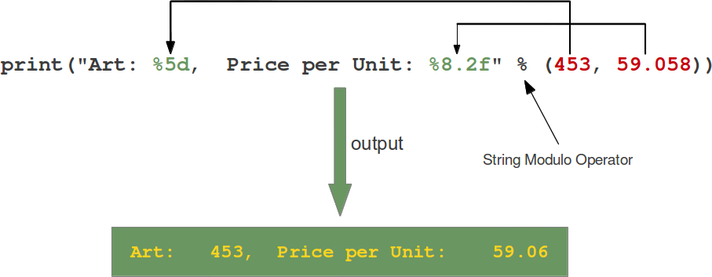
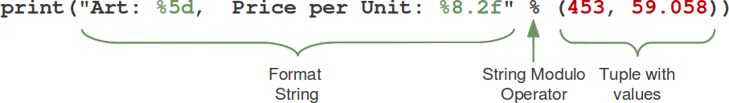
Formatted Output (Art of printing)??? What’s going on???
https://www.python-course.eu/python3_formatted_output.php

Slide 33
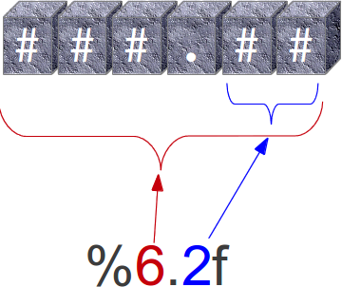
Formatted Output (Art of printing)??? What’s going on???
The format string contains placeholders. There are two of those in our example: "%5d" and "%8.2f".
The general syntax for a format placeholder is:
%[flags][width][.precision]type
https://www.python-course.eu/python3_formatted_output.php

Slide 34
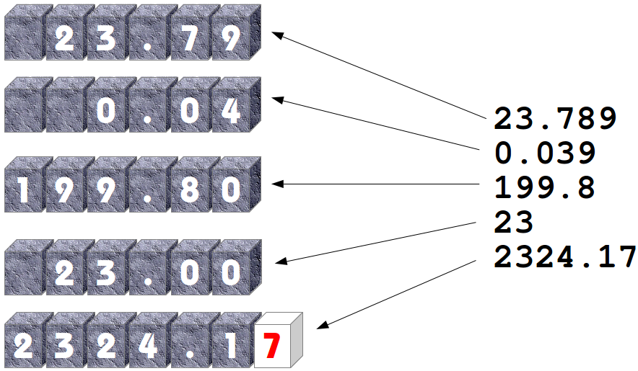
Formatted Output (Art of printing)??? What’s going on???
https://www.python-course.eu/python3_formatted_output.php

Slide 35
Conversion | Meaning
d | Signed integer decimal.
i | Signed integer decimal.
o | Unsigned octal.
u | Obsolete and equivalent to 'd', i.e. signed integer decimal.
x | Unsigned hexadecimal (lowercase).
X | Unsigned hexadecimal (uppercase).
e | Floating point exponential format (lowercase).
E | Floating point exponential format (uppercase).
f | Floating point decimal format.
F | Floating point decimal format.
g | Same as "e" if exponent is greater than -4 or less than precision, "f" otherwise.
G | Same as "E" if exponent is greater than -4 or less than precision, "F" otherwise.
c | Single character (accepts integer or single character string).
r | String (converts any python object using repr()).
s | String (converts any python object using str()).
% | No argument is converted, results in a "%" character in the result.

Slide 36
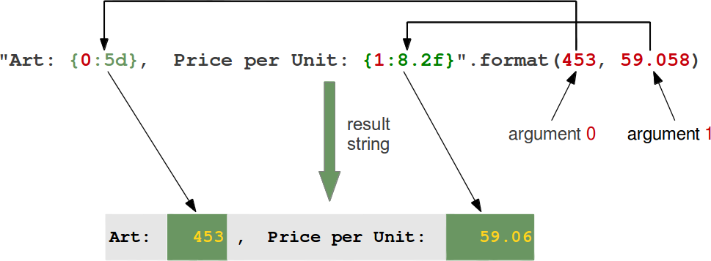
Formatted Output (Art of printing)??? What’s going on???
https://www.python-course.eu/python3_formatted_output.php

Slide 37
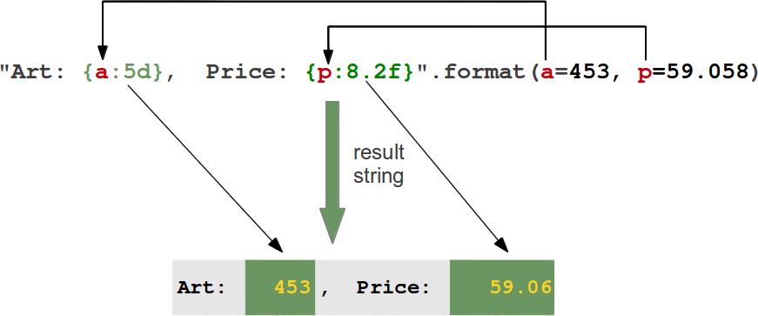
Formatted Output (Art of printing)??? What’s going on???
https://www.python-course.eu/python3_formatted_output.php

Slide 38
Formatted Output (Art of printing)
>>> print('%-5d%-6d' %(12,789)) #left justify
12 789
>>> print('%5d%6d' %(12,789)) #right justify
12 789
>>> print('{0:<5}{1:<6}'.format(12,789)) #left justify
12 789
>>> print('{0:>5}{1:>6}'.format(12,789)) #right justify
12 789

Slide 39
We need data? How to get it?

Slide 40

We need data? How to get it?
Use input function
Stop execution and wait for the user to give input via keyboard (Obviously, many other input resources exist)
Can have an optional String parameter as a message to help the user
Reads the input and returns as a String
If you need some other type convert that

Slide 41

We need data? How to get it?
response = input(‘Is python fun? ’)
print(‘Did you say ’ + response + ’?’)
Is python fun? yes
Did you say yes?
number = int(input(‘Number:’))
print(number*number)
Number:3
9

Slide 42
Is Python broken?
>>> number = int(input())
3
>>> print(number + ' sq is ' + number * number)
Traceback (most recent call last):
File "<stdin>", line 1, in <module>
TypeError: unsupported operand type(s) for +: 'int' and 'str'
>>> print(' sq is ' + number * number)
Traceback (most recent call last):
File "<stdin>", line 1, in <module>
TypeError: can only concatenate str (not "int") to str
>>> s = 2 + '2'
Traceback (most recent call last):
File "<stdin>", line 1, in <module>
TypeError: unsupported operand type(s) for +: 'int' and 'str'
>>> s = '2’ + 2
Traceback (most recent call last):
File "<stdin>", line 1, in <module>
TypeError: can only concatenate str (not "int") to str
>>> 2 + int('2')
4
>>> str(2) + '2'
'22'

Slide 43
THE REST IS OPTIONAL: READ FOR FUN

Slide 44

To Compile or not to Compile?
Python does the job but if you want to compile
>>> import py_compile
>>> py_compile.compile('program.py’)
OR
python -m py_compile program.py
OR compile all source files
python –m compileall .

Slide 45


To Compile or not to Compile?
Don’t worry about compiling Python code.
The compilation is hidden from the user
Files with the .pyc suffix
If Python has write-access➔ store the compiled byte code (.pyc suffix)
Else the program will work anyway
The byte code will be produced but discarded when the program exits

Slide 46

To Compile or not to Compile?
Python program is called➔ find the compiled version (.pyc file)
If it is created before, it must be newer than the source file( .py file).
If found, load the byte code and speed up the start up time of the script
Otherwise, Python will create the byte code
Execution of a Python program means execution of the byte code on the Python Virtual Machine (PVM).

Slide 47

HELP!!!
>>> help()
Welcome to Python 3.8's help utility!
If this is your first-time using Python, you should definitely check out
the tutorial on the Internet at https://docs.python.org/3.8/tutorial/.
Enter the name of any module, keyword, or topic to get help on writing
Python programs and using Python modules. To quit this help utility and return to the interpreter, just type "quit".
To get a list of available modules, keywords, symbols, or topics, type
"modules", "keywords", "symbols", or "topics". Each module also comes with a one-line summary of what it does; to list the modules whose name or summary contain a given string such as "spam", type "modules spam".
help>

Slide 48

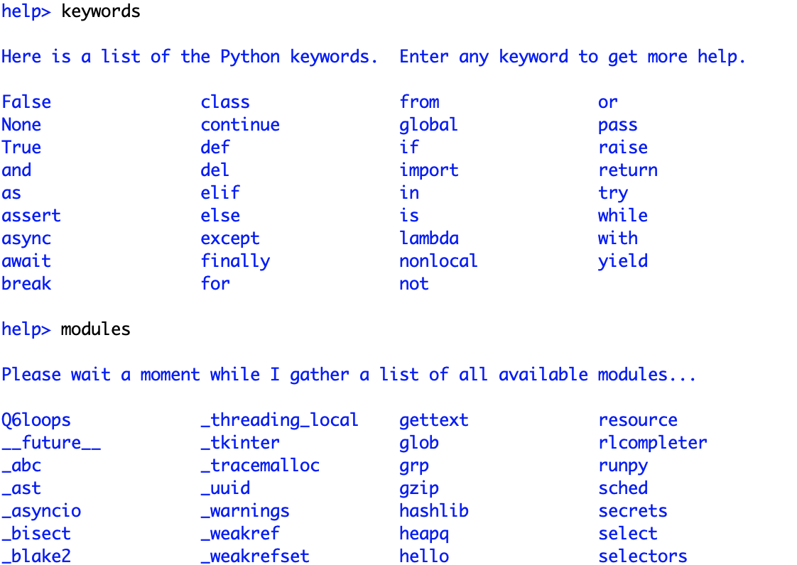

Slide 49
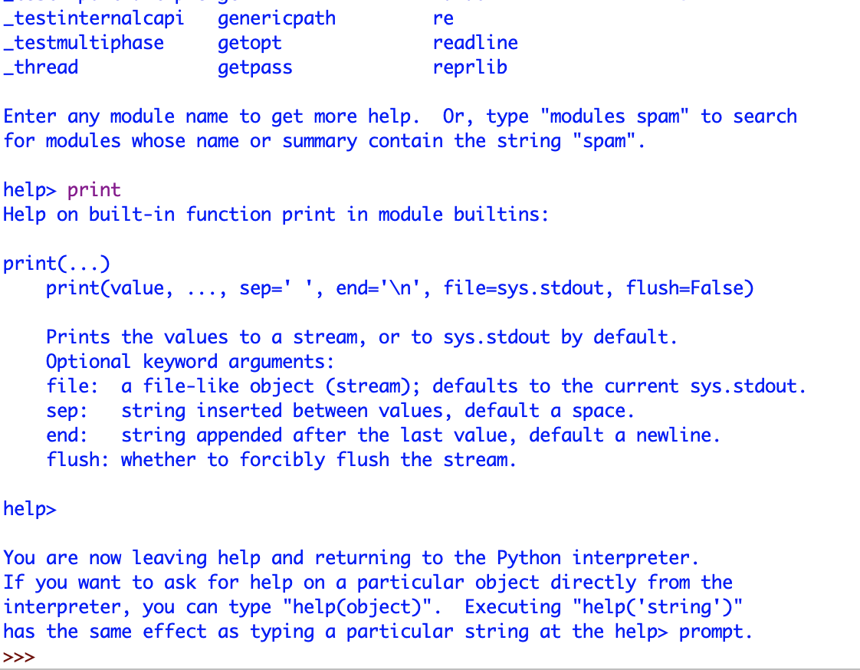

Slide 50
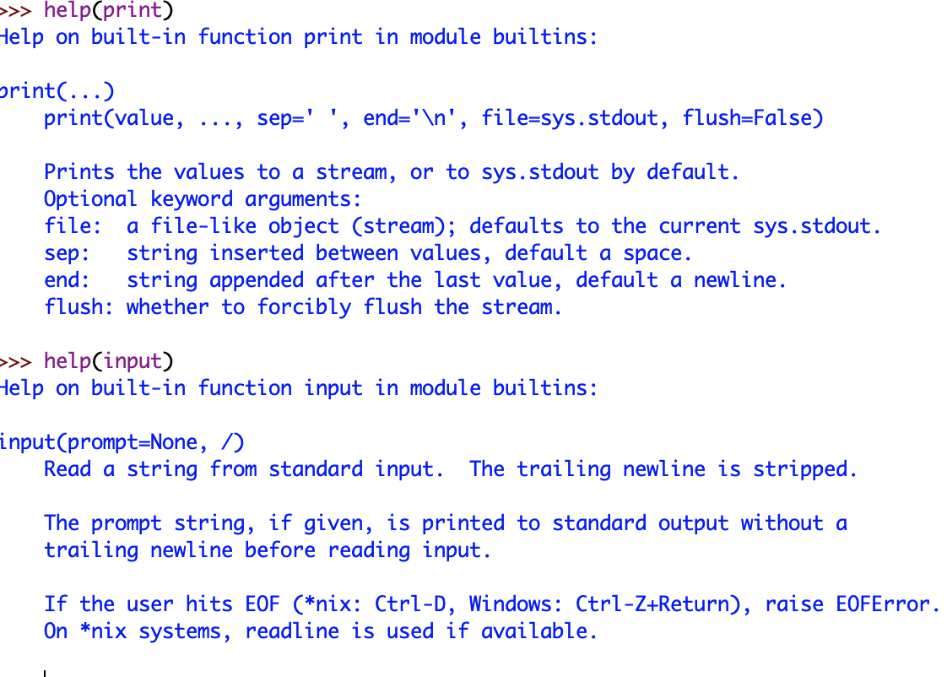

Slide 51

THIS IS NOT OPTIONAL DO NOT FORGET TO PRACTICE

